Slide 1
This presentation (5-10 min) offers instructions for the players
(installing the application and playing the game)
You can introduce changes and adapt these instructions to your specific game. Delete irrelevant slides.
Fill in the name and number of your game (last slide).
Faculty of Instructional Technology
Holon Institute of Technology

Slide 2
How to plAy

Slide 3
Preparing for the game
A game is conducted as a competition between teams or individuals. During the game you will be challenged to identify specific locations (stations) and to reach them.
The app will confirm arrival to the station, then present the related tasks.
The clues directing to the next station will appear only after successfully completing all tasks related to a station.

Slide 4
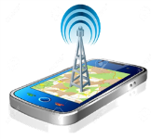
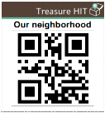
The game flow
Next Station according to the order defined by game creator
(identical for all, different, selected, random…)
Feedback & support
Next task
No
No
No
Introduction
Clue/s directing to a station
Tasks
at the station
Arrival ?
(GPS or Barcode)
Yes
Yes
All stations completed?
Tasks
completed?
Yes
Summary
(results, artifacts sharing)

Slide 5
Preparing for the game
Each team plays with ONE Smartphone/Tablet that supports:
Location detection (GPS)
Web browsing
The battery should be fully loaded.
Other devices may be used to look up information and for communication.

Slide 6
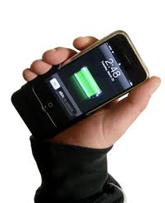
Preparing for the game
Form teams (ideally 3 members)
Install the app (ONE device for team)
Select the game
Register team
Play ….
Make sure
that the battery is fully charged
and the sound is activated.

Slide 7
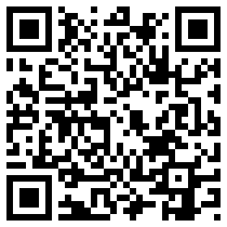
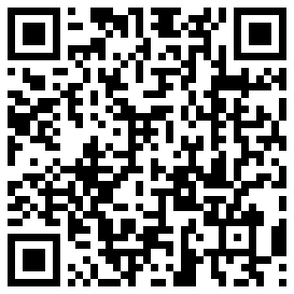
Installing the app
Android + 4.1 | iOS 6.0 +
Play Store | App Store | 1. Open
Treasure-hit | Treasure-hit | 2. Look for
 |  | 3. Install
or scan the QR code and install

Slide 8
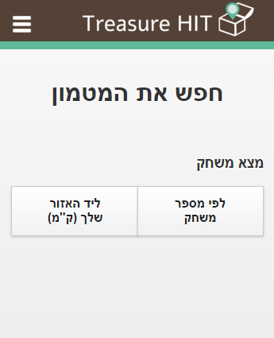
Language setting
If the interface is NOT in English click the setup menu and select “English”.

Slide 9
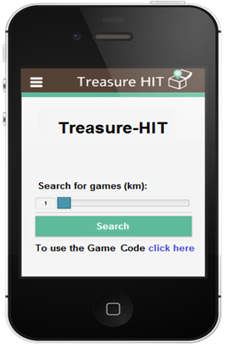
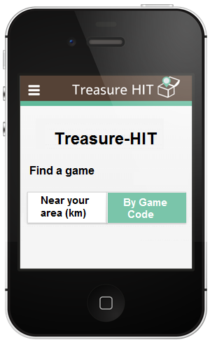
Selecting the game
Find your game by the Game Code
iOS
Android
The game manager
will reveal the Code
in a few minutes

Slide 10
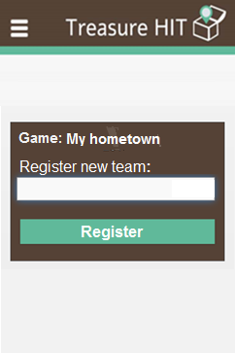
Register the team
After selecting the game you’ll be asked to enter a name for your team.
From now on the device will remember this team and all its actions.
If for any reason the app will close, all you have to do is to reopen it and select this name. The app will bring you back exactly where you left off.
Big lions

Slide 11
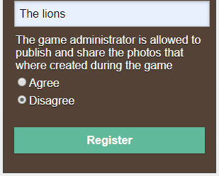
Register the team
After selecting the game you’ll be asked to enter a name for your team, and choose if the game administrator is allowed to publish and share the photos that where created during it.
From now on the device will remember this team and all its actions.
If for any reason the app will close, all you have to do is to reopen it and select this name. The app will bring you back exactly where you left off.
Big lions

Slide 12
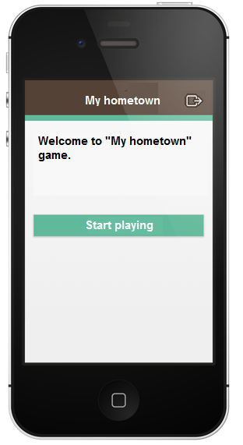
Start playing
After the welcome message (text or video) you can start playing.

Slide 13
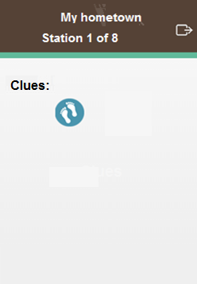
The clue/s
The clue/s directing to a station will appear.
Click a Clue icon.
More than one clue may be available.

Slide 14
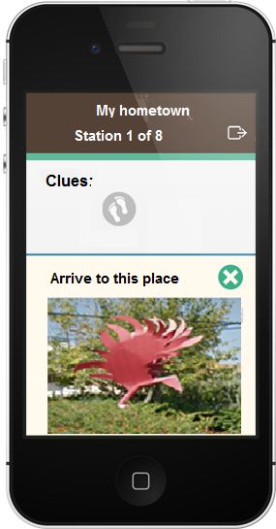
The clue/s
The clue will be presented.
You may close a clue and view others – if available.
Identify the place and reach it.
After viewing one clue you may check if you have reached the correct location.
Close the clue by pressing

Slide 15
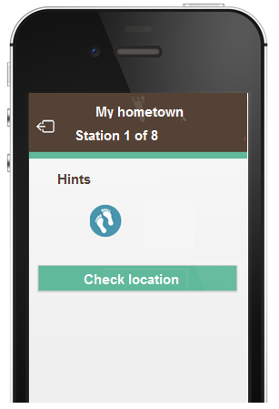
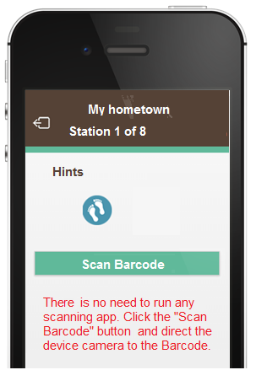
Check location
GPS stations
Barcode stations
Make sure that the GPS is activated
and wait until it functions properly
Notes:
Adjust to your specific game…

Slide 16
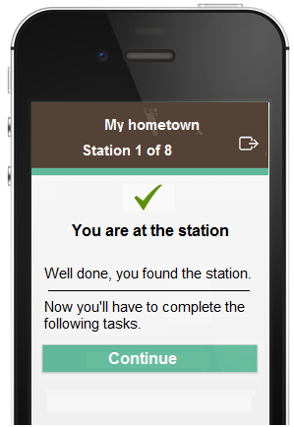
Arrival to a station
If you have arrived to the correct place you will receive a confirmation message
and will be presented with the tasks related to the station.

Slide 17
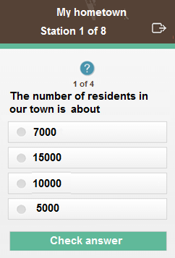
Tasks – Single choice
Some tasks may have one correct answer.
Select it by clicking the radio button,
then “Check answer”.

Slide 18
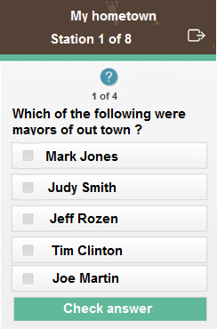
Task – Multiple choice
Some tasks may have several correct answers.
Select ALL the correct answers by clicking their checkboxes,
then “Check answer”.
The system does not accept partial answers .
You will not be able to continue until you got the complete correct answer.

Slide 19
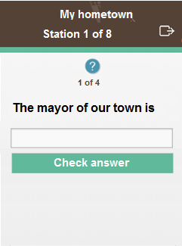
Task – Open question
You may be presented with open questions and asked to type the answer.
When clicking this area
a keyboard will appear.
Type your answer
then “Check answer”.

Slide 20
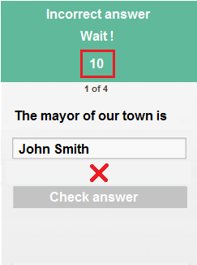
Guessing …
If you do not know the answer to a question, it is not advisable to just guess:
You may be delayed after a repeated mistake.
Mistakes will affect your final ranking in the game.
Look for the answer around you, use the web, consult with your team mates or with other people.

Slide 21
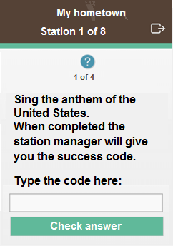
Physical Challenges
A game may include tasks that are performed outside the app.
Upon completion of the task the station manager will provide you with the success code:

Slide 22
Creative Tasks
You may be asked to create digital products, such as:
write a limerick, a short story, your impressions of …
take a picture
produce a video upload it to YouTube and provide the link
Just follow the instructions presented.

Slide 23
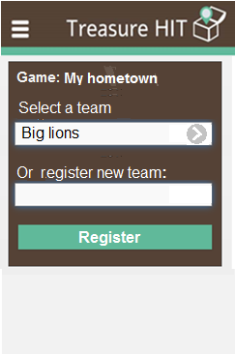
App closed ?
What if the app closes for any reason while playing?
Open the Treasure-HIT app.
Enter the game code.
The name you have registered with will appear -select it - the app will bring you back exactly where you left off.
Do NOT enter a new name.

Slide 24
Empty battery ?
What if the battery runs out?
You will not be able to continue (as the team that registered on this device) until you recharge the battery.
You will have to use another device and start from scratch…

Slide 25
General Instructions
Optional – insert relevant info such as:
Regardless of whether you have finished the game or not please get back here at XX:XX.
If you encounter any problems during the game please call the game manager, Tel.: XXXXXXXX.

Slide 26
Enjoy !
Your game is: game name
Game code: XXXXX
Notes:
Enter the name and code of your game

